Slide 1
BIOE 498 / BIOE 599: Computational Systems Biology for Medical Applications CSE 599V: Advancing Biomedical Models Lecture 14: Data Management for BioMedical Models
Joseph L. Hellerstein*
Herbert Sauro**
*eScience Institute, Computer Science & Engineering
**BioEngineering

Slide 2

Biological Data

Slide 3
Requirements & Solutions
Requirement
Solution
Find the data
Provenance
Know data semantics
Ease of update
Ease of query
Ease of storage
Validate consistency
Version control
Version control
Documentation
Data management
Data management
Data management
Data tests

Slide 4
Agenda
Case study – Co-evolution of 2 microbes
Data modeling primer and application to case study
SQL with demo
Building SQL repositories in python
In-class exercise

Slide 5
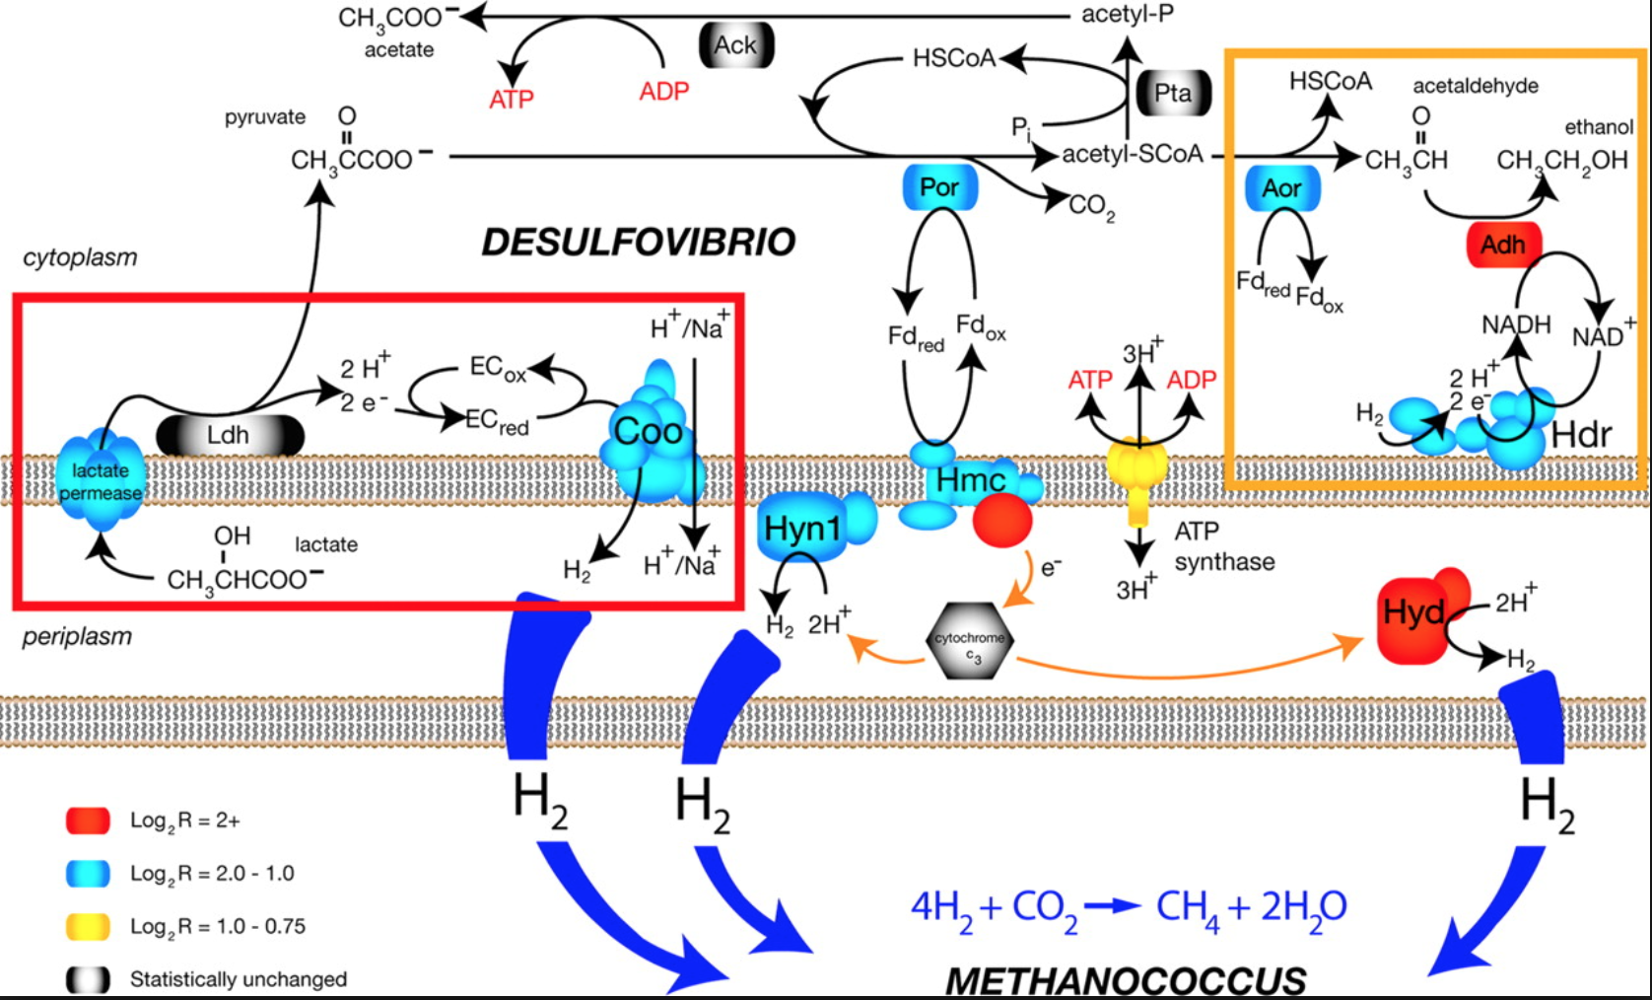
Case Study – Co-evolution of Desulfovibrio vulgaris Hildenborough (DVH) & Methanococcus maripaludis (MMP)
DVH
MMP
Together

Slide 6
Experiments & Data Collected
Resistance = {R,E,S,A}
DVH
MMP
Line = {H,U} X {R,E,S,A}
not resistant
resistant
not resistant
H
U
H
U
H
U
H
U
Line Replicas
End Point Dilutions
1,000 generations
DVH
Isolate
MMP
Isolate
Mutation Data
Mutation Data
Culture
Growth
Data

Slide 7
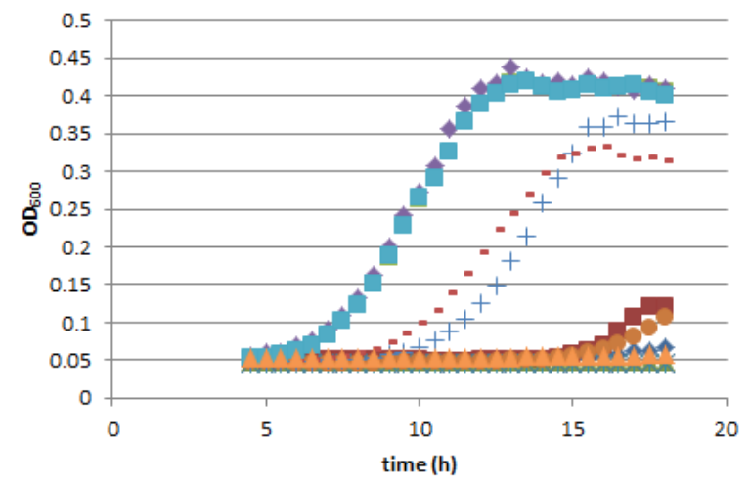
Growth Rate and Yield
Rate is slope of exponential growth
Yield is plateau

Slide 8
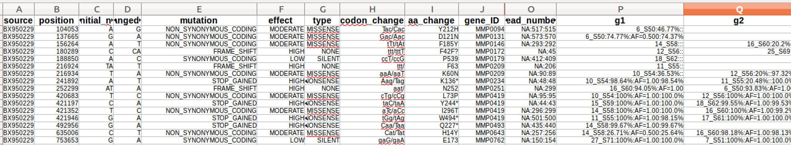
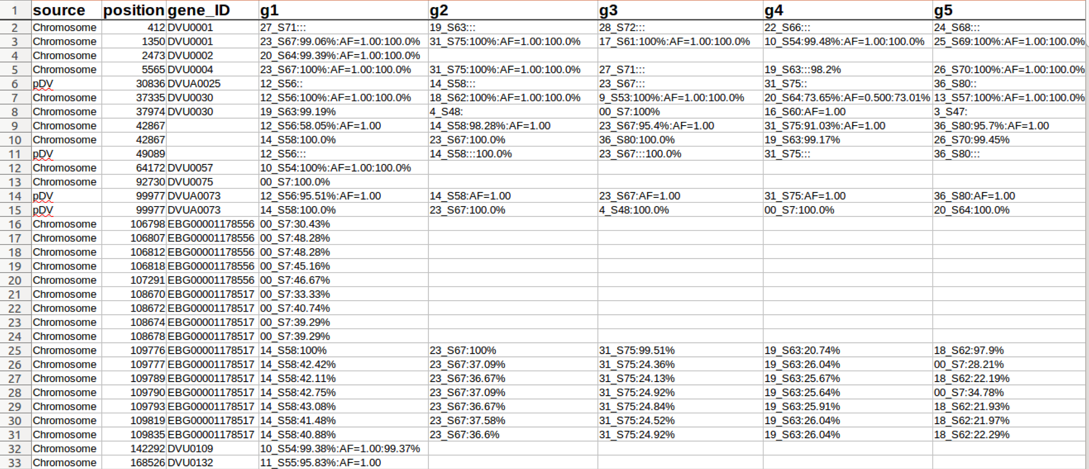
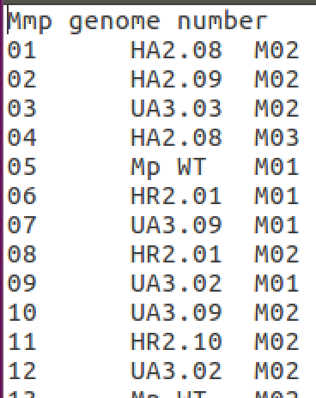
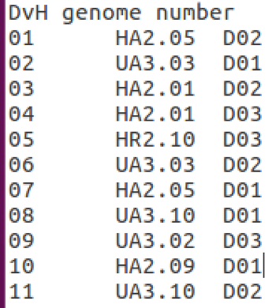
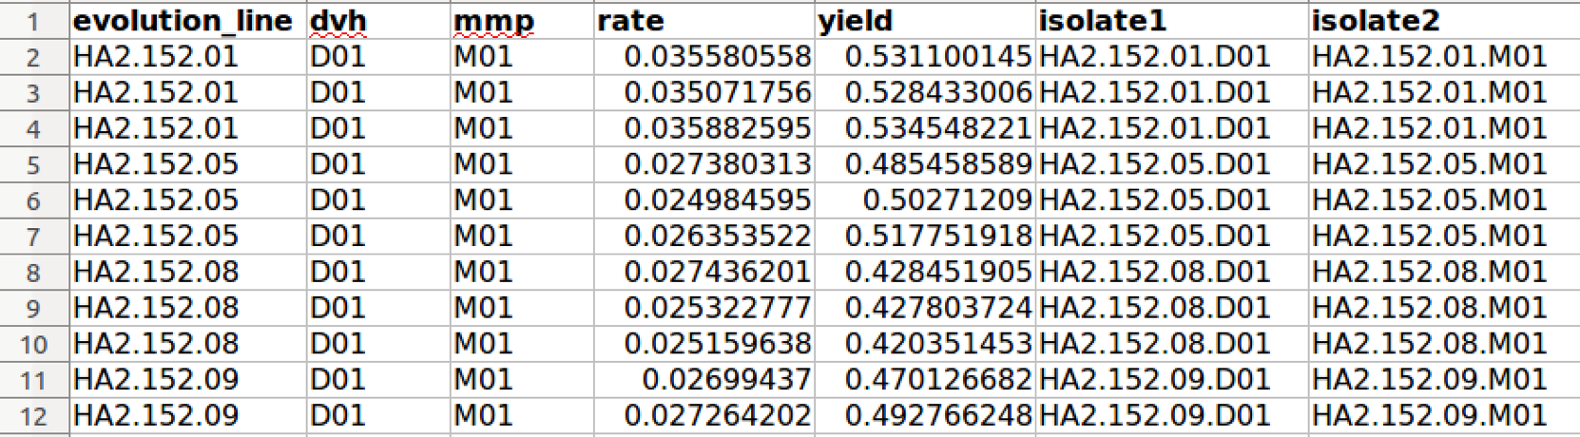
Raw Data
mmp_mutations.xlsx
dvh_mutations.xlsx
names_colonal_isolates_dvh.txt
names_colonal_isolates_mmp.txt
Complex
Error prone
Inflexible
growth_data.xlsx

Slide 9
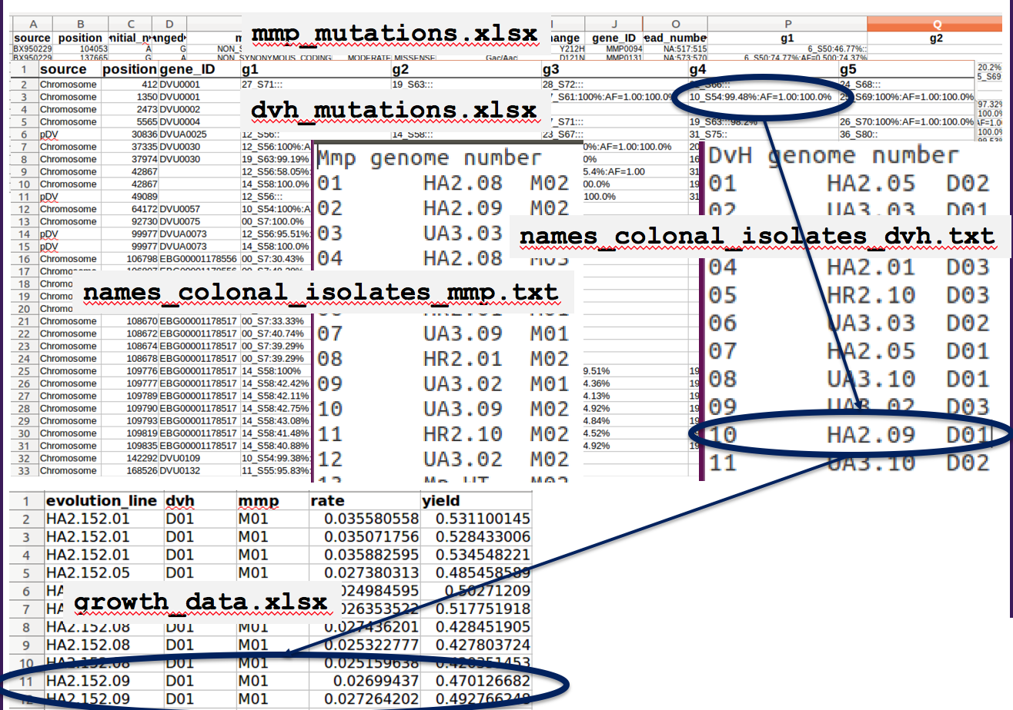
Challenges
Difficult to navigate
Not easily extended
Augment with gene descriptions?
Incomplete information
Implied transfer times and community

Slide 10
Exposing Hidden Information What is an Isolate?
H
U
H
U
H
U
H
U
Line = {H, U} X {R, E, S, A}
Required information
Line
Transfer time
Endpoint dilution
Clone number
Species
Experiment (isolate or cell)
Extension to communities
All cells in an endpoint dilution at a transfer time
All cells in a line at a transfer time
How do we know when we’ve exposed all necessary information?
When we have a “key” – uniquely identifies the community
DVH
Isolate
MMP
Isolate
Mutation
Mutation
Culture

Slide 11
Naming Isolates (Communities)
H
U
H
U
H
U
H
U
Line = {H, U} X {R, E, S, A}
HA2.152.03.02.D.CI
Line HA2, transfer 152, EPD 03, Clone 02, Species DVH, Clonal Isolate
HA2.152.03.*.*.CI
Line HA2, transfer 152, EPD 03, Clonal Isolates
HA2.152.*.*.*CI
Line HA2, transfer 152, Clonal Isolates
DVH
Isolate
MMP
Isolate
Mutation
Mutation
Culture

Slide 12
What’s Missing in the Isolate Naming? HA2.152.03.02.D.CI, HA2.152.03.*.*.CI, HA2.152.03.*.*.CI
Line replicas are part of the line name?
Using term “Isolate” when it should be a community.

Slide 13
Data Modeling I: Identify Core Concepts
What nouns are required to precisely describe a science question for these data? The CS term for these nouns is Class.
Community (Isolate)
A cell or group of cells.
Key: line, transfer, EPD, clone, species, experiment
Mutation
A change in the genome at a location.
Key: position, new nucleotides
Culture
The environment in which cells are grown and phenotype is measured.
Key: Community, conditions
H
U
H
U
H
U
H
U
Line = {H, U} X {R, E, S, A}
DVH
Isolate
MMP
Isolate
Mutation
Mutation
Culture

Slide 14
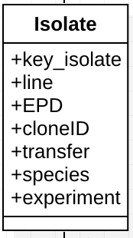
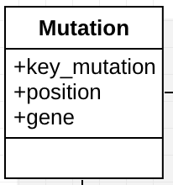
Data Modeling II: Identify Attributes
What qualifiers (descriptors) are needed to precisely identify an instance of a noun (class)?

Slide 15
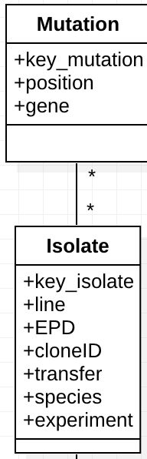
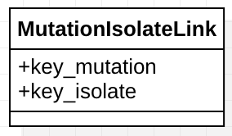
Data Modeling IIIa: Specify Relationships
How do classes (nouns) relate to one another so that information can be “correlated” between classes?
Representing relationships between different classes often requires a new class that specifies associations between keys.

Slide 16
Data Modeling IIIb: Relationships

Slide 17
Data Modeling IIIc: Relationships
GeneDescription provides details about the gene.

Slide 18
Navigations for a Science Question
What is the average growth rate for each mutation?
Navigate from Mutation to Isolate to find key_isolate associate with a mutation.
Navigate from Isolate to Culture using key_isolate and key_culture.
Compute the averages

Slide 19
Why Not Just Have a Single Table? Referred to as Denormalization
key_mutation | key_isolate | key_culture | growth_rate
DVU1295.123 | HA2.152.03.01.D.CI | C1 | 0.13
DVU1295.123 | HA2.152.03.01.D.CI | C3 | 0.15
DVU2365.4569 | HA2.152.03.01.D.CI | C1 | 0.13
DVU2365.4569 | HA2.152.03.01.D.CI | C3 | 0.15
Multiple Tables
Navigate Mutation to Isolate to find key_isolate associate with a mutation.
Navigate from Isolate to Culture using key_isolate and key_culture.
Compute average growth_rate for the mutation
Single Table.
Select rows with the mutation
Compute the average of growth_rate for those rows

Slide 20
Denormalizing via Joins
T1
key_mutation | key_isolate
DVU1295.123 | HA2.152.03.01.D.CI
DVU2365.4569 | HA2.152.03.01.D.CI
Use constraints
T1.key_isolate = T2.key_isolate
T2.key_culture = T3.key_culture
T2
Issues with denormalized tables
Phantom data
A single value must be updated in multiple places
Complicates some queries because of redundancies (e.g., count number of cultures).
key_isolate | key_culture
HA2.152.03.01.D.CI | C1
HA2.152.03.01.D.CI | C3
T3
key_culture | growth_rate
C1 | 0.13
C3 | 0.15
key_mutation | key_isolate | key_culture | growth_rate
DVU1295.123 | HA2.152.03.01.D.CI | C1 | 0.13
DVU1295.123 | HA2.152.03.01.D.CI | C3 | 0.15
DVU2365.4569 | HA2.152.03.01.D.CI | C1 | 0.13
DVU2365.4569 | HA2.152.03.01.D.CI | C3 | 0.15

Slide 21
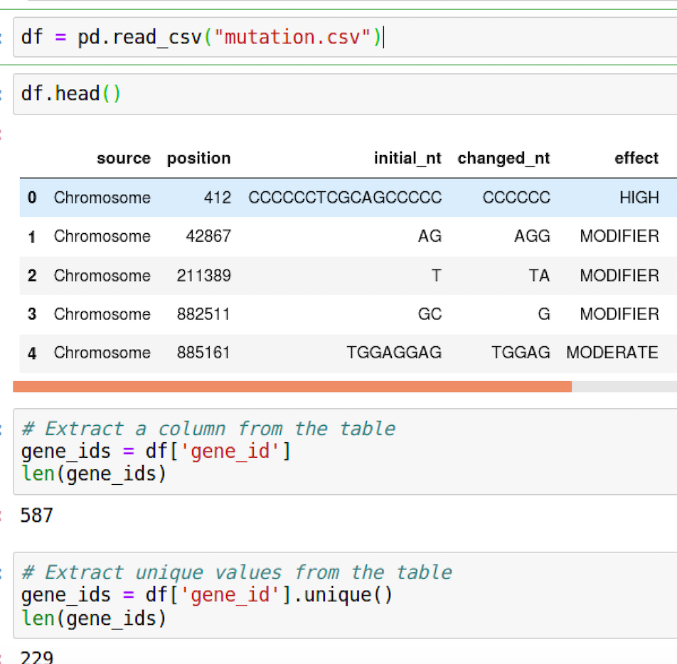
Pandas DataFrames: a Python Table

Slide 22
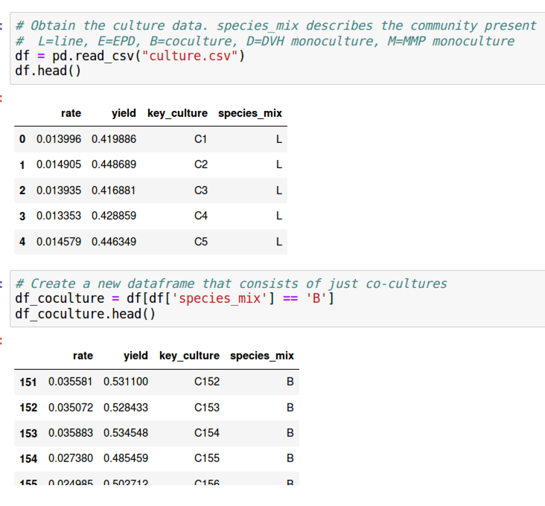
Data Manipulation I

Slide 23
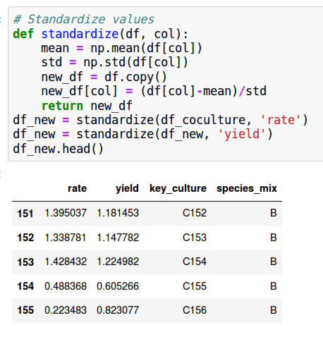
Data Manipulation II

Slide 24
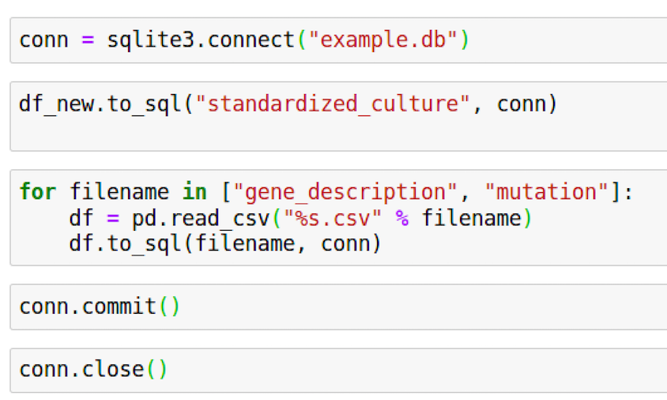
Using DataFrames With SQL

Slide 25
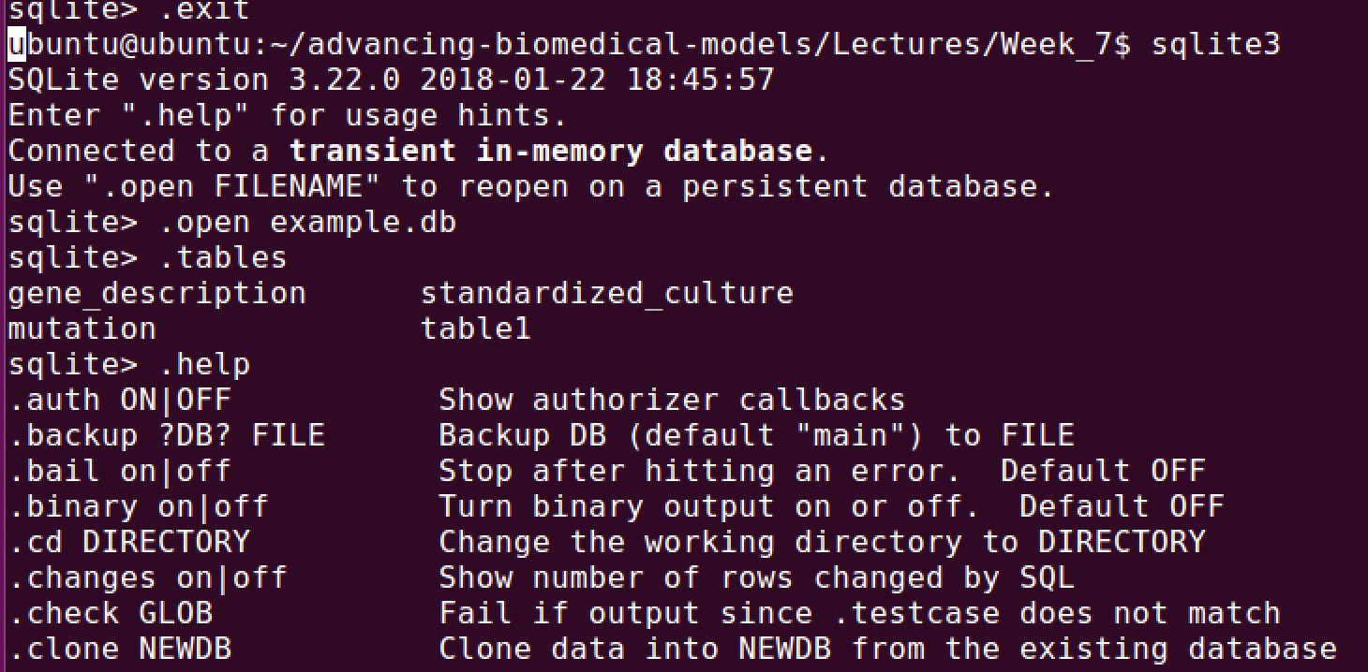
sqlite3 Command Line Interactions With SQL Files

Slide 26
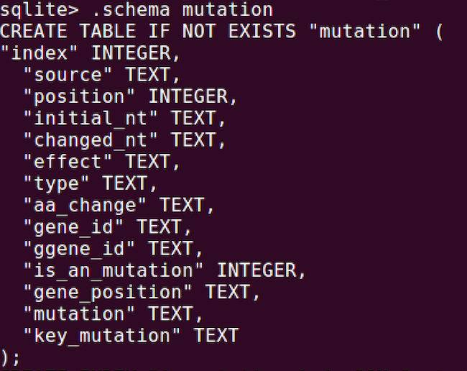
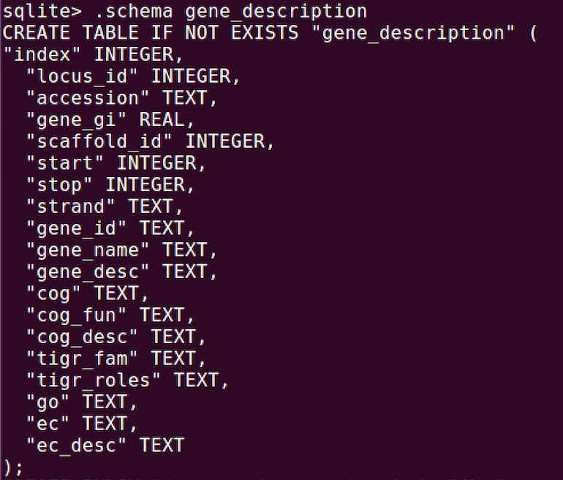
sqlite3 SQL Commands
select position, gene_desc from mutation, gene_description
where mutation.gene_id = gene_description.gene_id;

Slide 27
In Class Exercise
In a study of E. coli, CRISPR is used to modify several genes indicated in chemotaxis in different combinations with visual reporters of cell genotype. Movies are taken using live cell imaging to quantify cells movement across gradients of different magnitudes for different sugars. The movies are post-processed to produce tabular data.
What are the core concepts (“classes”) for describing science questions for these data?
What are the attributes for the classes?
How would you structure the data to answer the question “Which mutations cause the largest increase/smallest increase in movement for different sugars?”
Consider a structure of the data where there is a table of mutation data by cell with 2 columns “mutation ID and cell ID” and a table of movement data with 2 columns ”movement type” and “cell ID”.
Create two dataframes with synthetic data for these columns
Create a sqlite DB with tables corresponding to these dataframes
Do a query on the table that yields the join of the tables

